Slide 1
Syllabus: Synchronous Motor:
Principle of Operation,
Phasor Diagrams,
Torque and Torque Angle,
Blondal Diagram,
Effect of Change in Load,
Effect of Change in Excitation,
V and Inverted V Curves.
Synchronous Condenser,
Hunting and Damping.
Methods of Starting Synchronous Motors.

Slide 2
Principle of Operation,
A 3-phase synchronous motor is a 3-phase synchronous machine which is operated as a motor i.e. converts electrical energy input into mechanical energy output.
A synchronous motor has a unique feature that is it runs at a constant speed equal to the synchronous speed at all load provided that the load on the motor does not exceed the limiting value.

Slide 3
Principle of Operation,
A synchronous motor is a doubly-excited machine.
Its stator winding or armature winding is connected to the AC supply
The rotor winding or field winding is excited by a DC source.

Slide 4
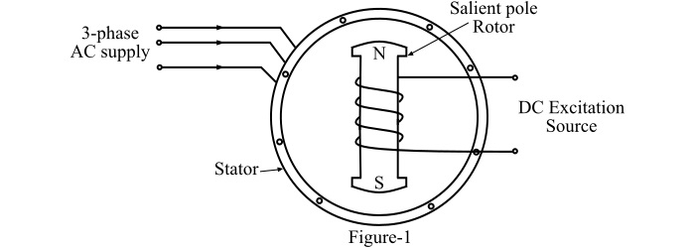
Construction of Three-Phase Synchronous Motor

Slide 5
Construction of Three-Phase Synchronous Motor
Stator
The stator is the stationary part of the machine and is built up of sheet steel laminations having slots on its inner periphery.
A three-phase winding is placed in these slots which is called armature winding and receives power from a 3-phase supply.

Slide 6
Construction of Three-Phase Synchronous Motor
Rotor
The rotor of the synchronous motor has set of salient poles carrying a field winding which is supplied with direct current through two slip-rings by a separate DC source to form alternate N and S poles.
The DC source is generally a small DC shunt generator mounted on the shaft of the motor.

Slide 7
Working Principle of Synchronous Motor
Consider a 3-phase, 2-pole synchronous motor having two rotor poles NR and SR as shown in Figure-2.
The stator is also being wound for two poles NS and SS.
A three-phase AC supply is connected to the stator winding and a DC voltage is applied to the rotor field winding.

Slide 8
Working Principle of Synchronous Motor
The stator winding produces a rotating magnetic field which revolves around the stator at synchronous speed.
The DC voltage applied to the rotor sets up a two-pole field which is stationary so long as the rotor is not running.
Hence, under this condition, there exists a pair of revolving stator poles (NS-SS)and a pair of stationary rotor poles (NR-SR).

Slide 9
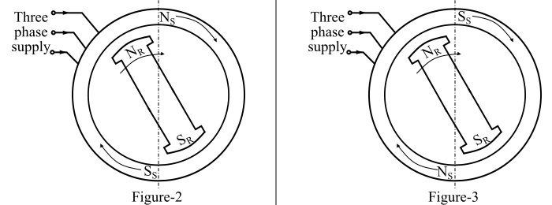
Working Principle of Synchronous Motor

Slide 10
Working Principle of Synchronous Motor
Now, suppose at any instant, the stator poles are at positions as shown in Figure-2. From Figure-2, it is clear that poles NS and NR repel each other and also at SS and SR.

Slide 11
Working Principle of Synchronous Motor
After a period of half-cycle of the AC supply, the polarities of the stator poles are reversed but the polarities of the rotor poles remain the same as shown in Figure-3. in the anticlockwise direction
Under this condition, the poles SS and NR attract each other and so do the poles NS and SR. Due to this, the rotor tends to move in the clockwise direction.

Slide 12
Why synchronous motor not self starting?
Since the stator poles change their polarities rapidly, they tend to pull the rotor first in one direction and then after a period of half cycle in the other direction.
But the rotor has high inertia, consequently, the rotor does not move and we say that the starting torque is zero.
In other words, a synchronous motor is not self starting.

Slide 13
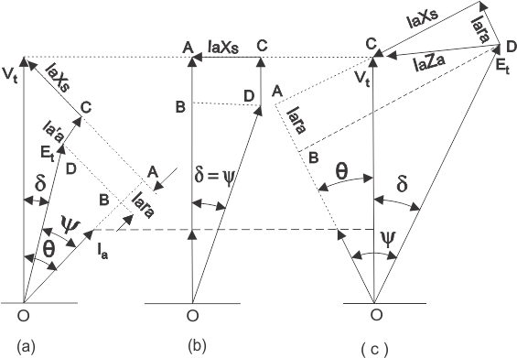
Phasor diagram of synchronous motor (a) Motoring operation at lagging power factor,(b) Motoring operation at unity power factor c) Motoring operation at leading power factor.

Slide 14
Torque and torque angle
The torque angle of the synchronous motor is defined by the angle between the air gap flux line and the rotor flux lines. The maximum value of torque angle in a synchronous motor is 90 degrees electrical.

Slide 15
Effect of change in load
When the load on a synchronous motor is increased, then
The motor continues to run at synchronous speed
The torque angle (δ) increases.
The magnitude of the excitation voltage (Ef) remains constant
The armature current (Ia) drawn from the supply increases.
When the load on a synchronous motor is decreased, then
The motor continues to run at synchronous speed.
The torque angle (Ia) decreases.
The magnitude of the excitation voltage (Ef) remains constant.
The armature current (Ia) drawn from the supply decreases.

Slide 16
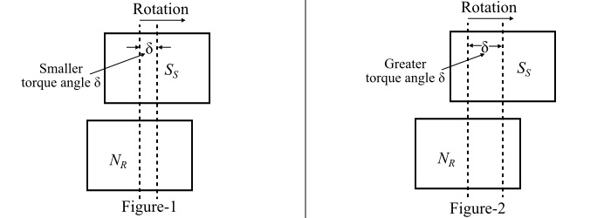
Effect of change in load

Slide 17
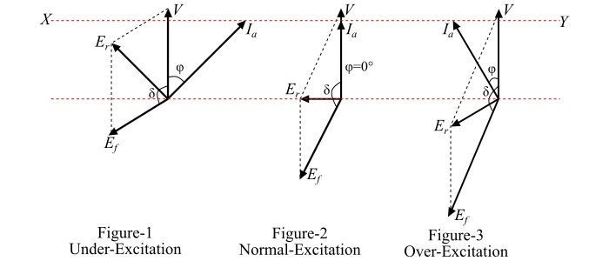
Effect of change in excitation
As the excitation is increased, the power factor improves till it becomes unity at normal excitation. Under such conditions, the current drawn from the supply is minimum. If the excitation is further increased (i.e., over excitation), the motor power factor becomes leading.

Slide 18
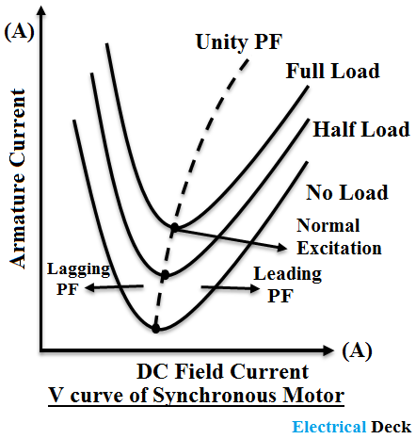
V and Inverted V Curves.

Slide 19
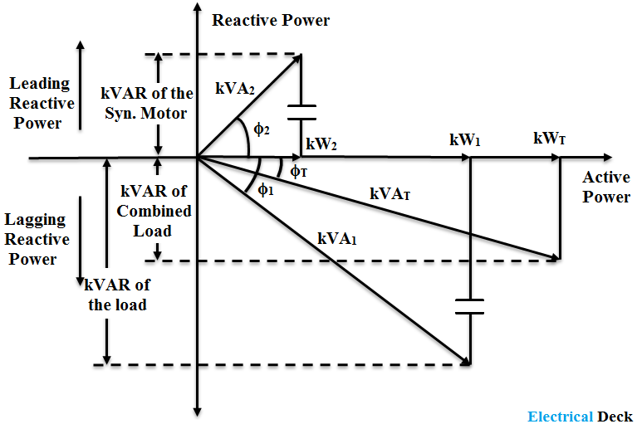
Synchronous condenser

Slide 20
Hunting in synchronous machine
Unloaded synchronous machine has zero degree load angle.
On increasing the shaft load gradually load angle will increase.
Let us consider that load P1 is applied suddenly to unloaded machine shaft so machine will slow down momentarily.
Also load angle (δ) increases from zero degree and becomes δ1.
During the first swing electrical power developed is equal to mechanical load P1.
Equilibrium is not established so rotor swings further.
Load angle exceeds δ1 and becomes δ2.
Now electrical power generated is greater than the previous one.
Rotor attains synchronous speed.
But it does not stay in synchronous speed and it will continue to increase beyond synchronous speed.
As a result of rotor acceleration above synchronous speed the load angle decreases.
So once again no equilibrium is attained.
Thus rotor swings or oscillates about new equilibrium position.
This phenomenon is known as hunting or phase swinging.
Hunting occurs not only in synchronous motors but also in synchronous generators upon abrupt change in load.

Slide 21
Damping in synchronous motor
Damping is the phenomenon caused in synchronous machine due to the sudden change in load.

Slide 22
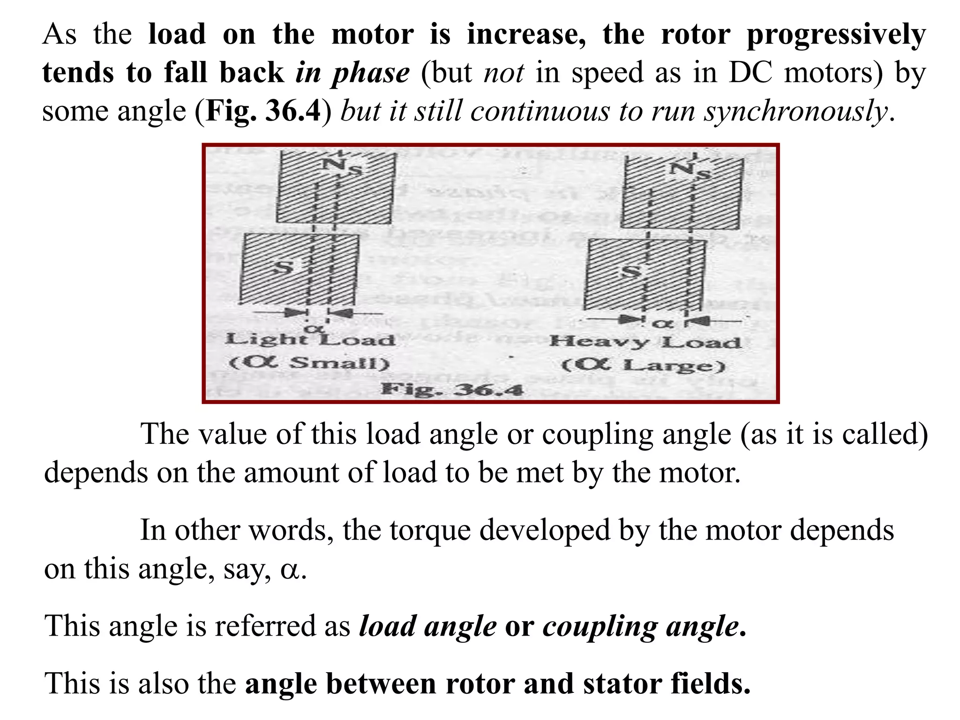
CONSTANT EXCITATION VARIABLE EXCITATION

Slide 23
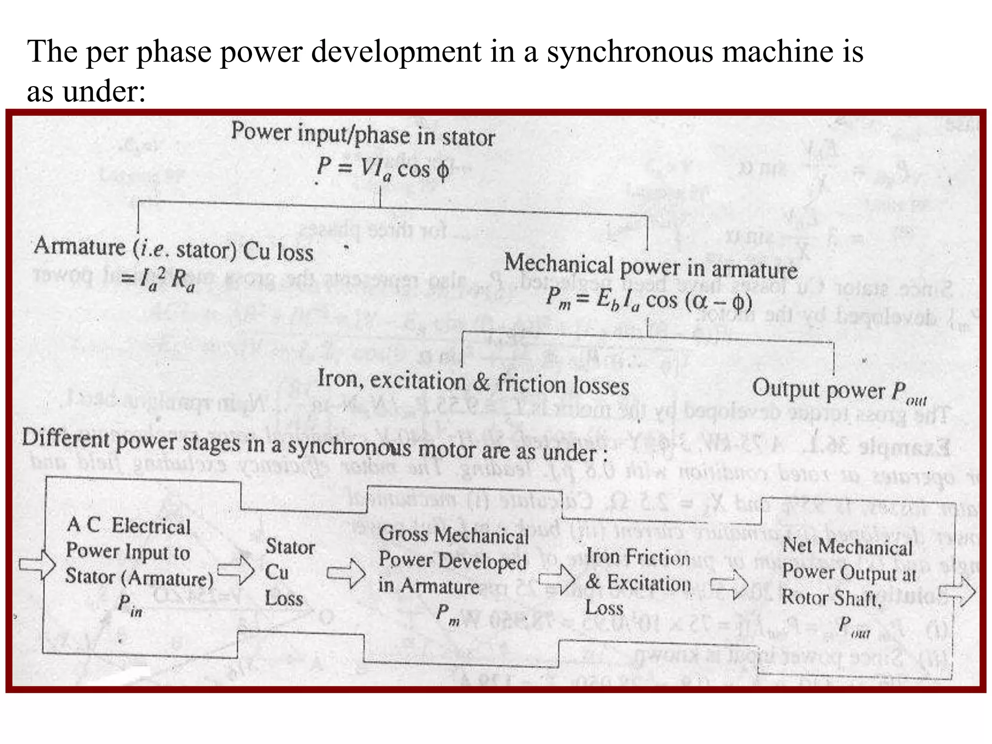
LOSSESS IN SYNCHRONOUS MOTOR

Slide 24
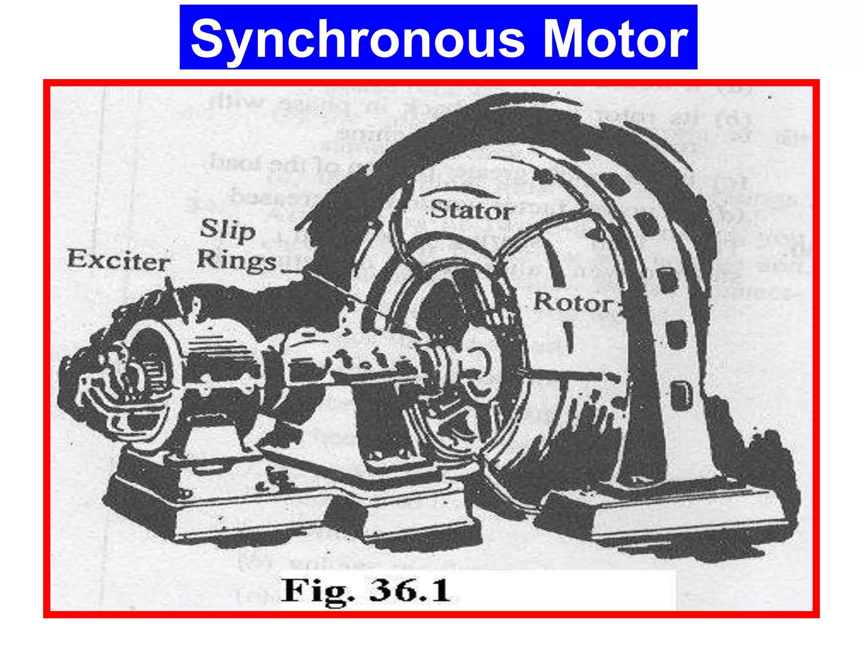
STARTING OF SYNCHRONOUS MOTOR

Slide 25
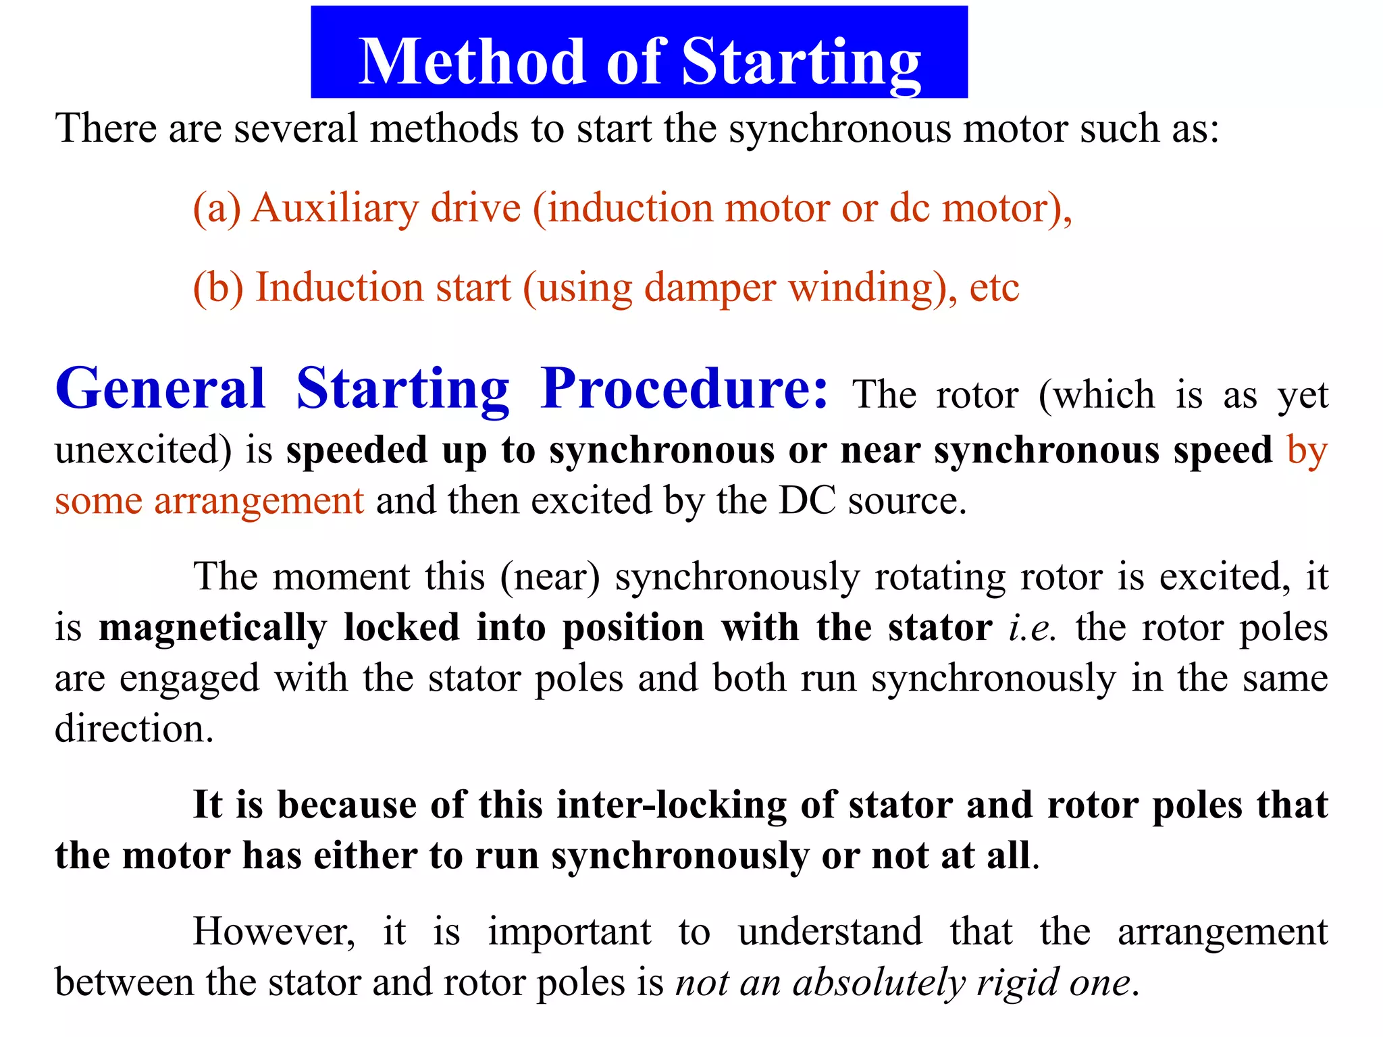

Slide 26
DIFFERENT METHODS OF STARTING SM
Using Auto transformer
Asynchronous motor
using small motor (induction motor or a dc motor)
Damper winding.

Slide 27
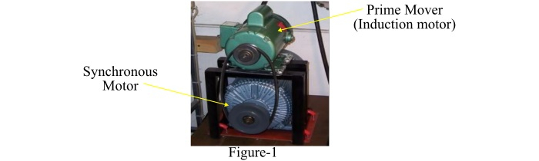
Methods of starting synchronous motor

Slide 28
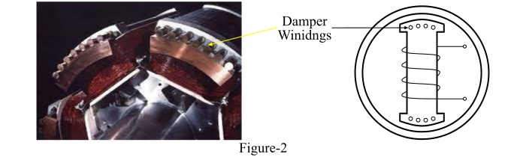
Using damper winding

Slide 29
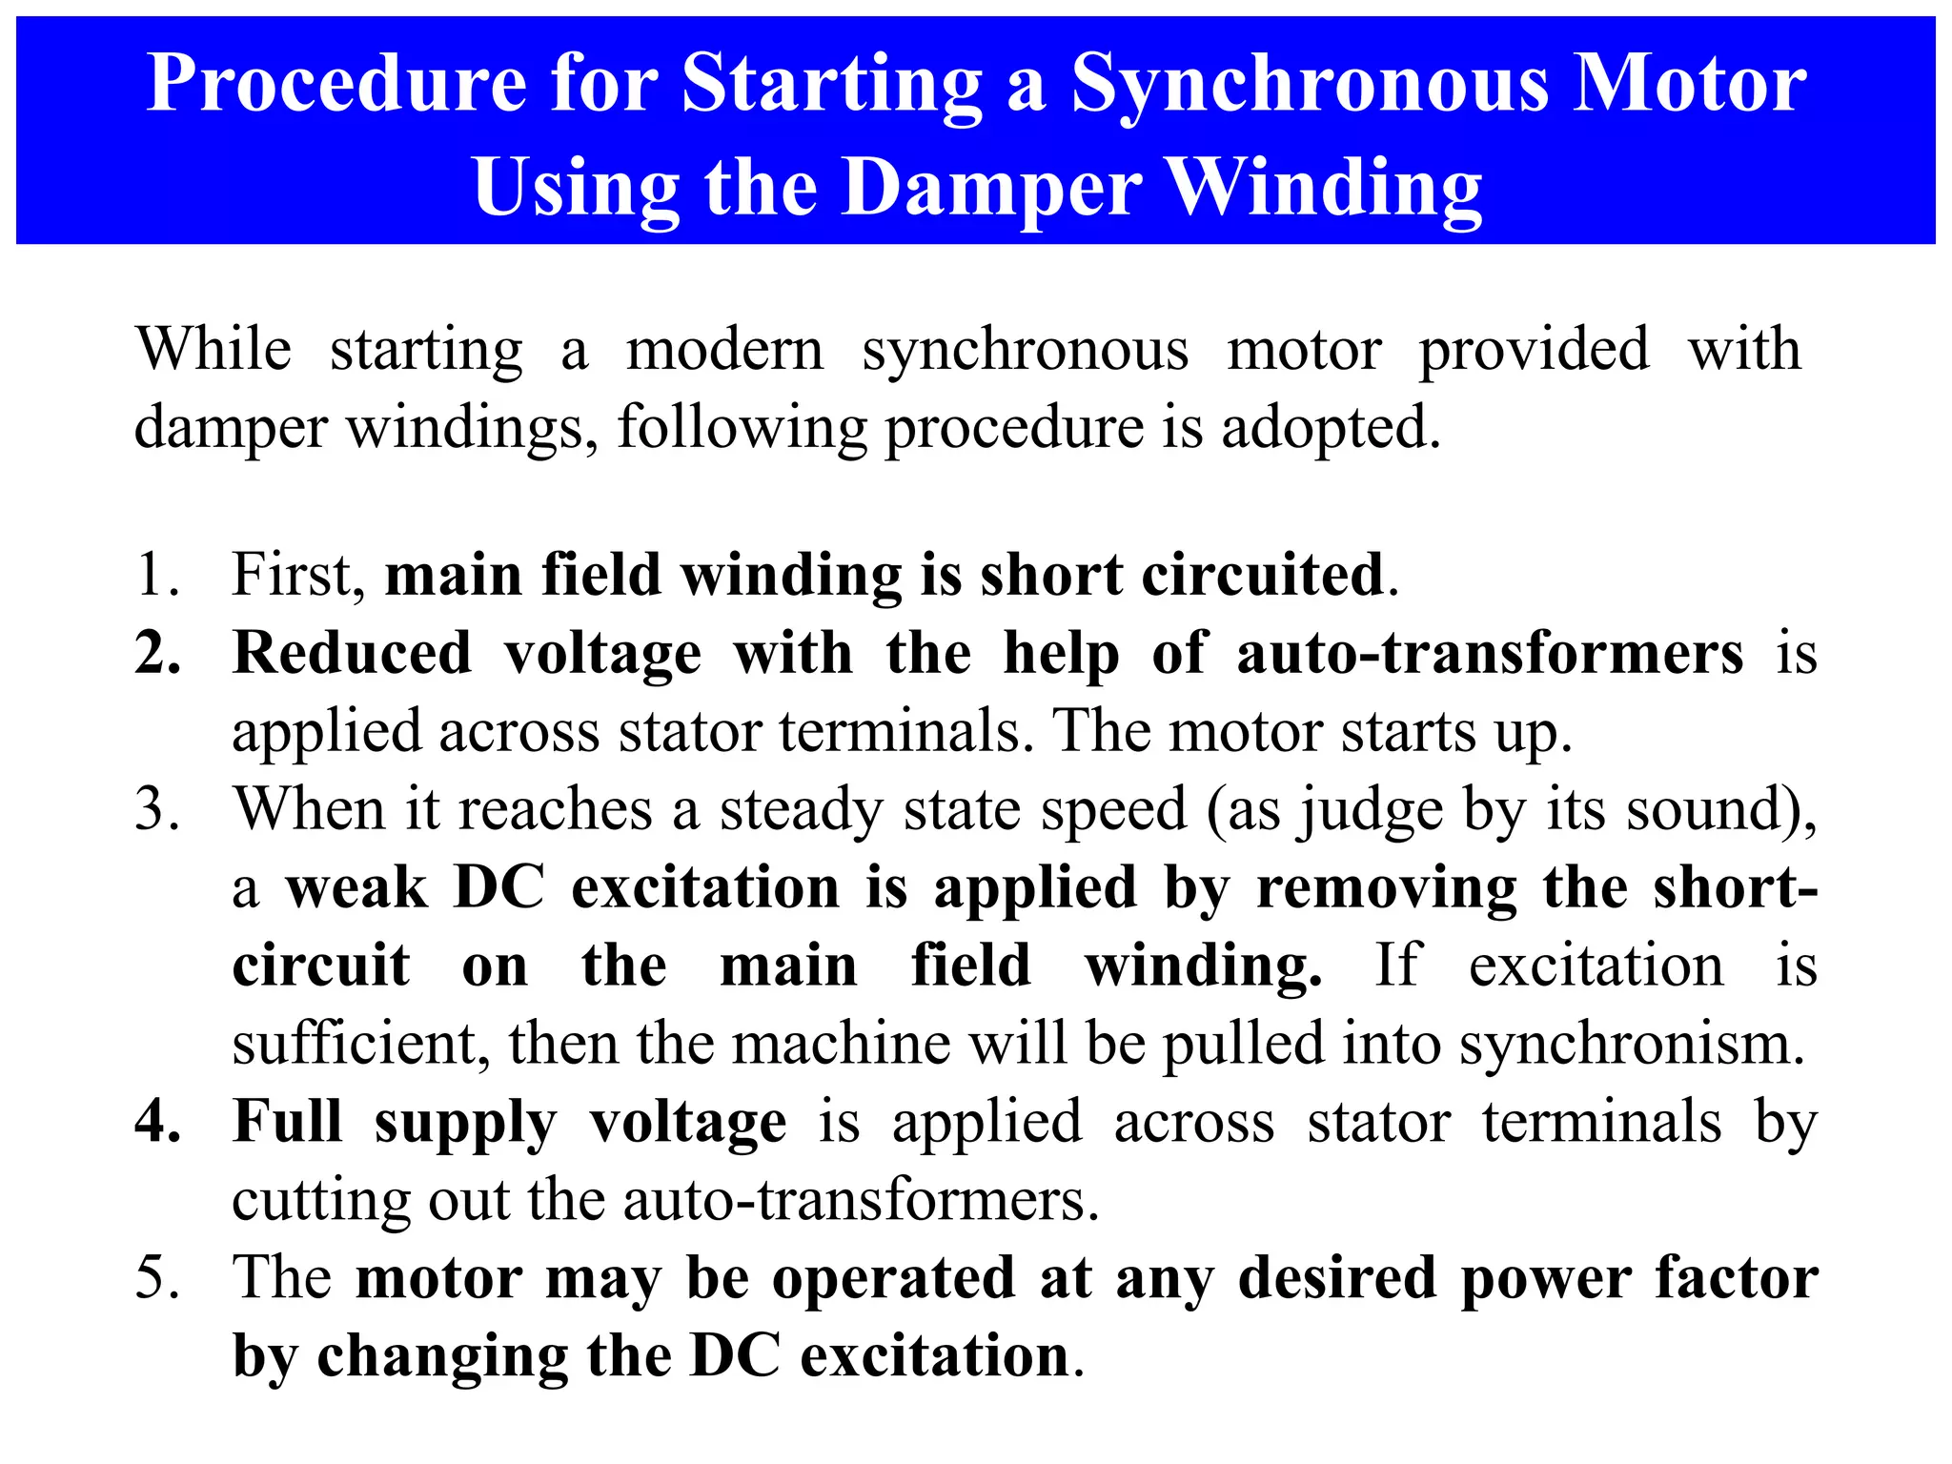

Slide 30
Difference Between Synchronous and Asynchronous Motor are explained below in the tabulated form.
BASIS | SYNCHRONOUS MOTOR | ASYNCHRONOUS MOTOR
Definition | Synchronous motor is a machine whose rotor speed and the speed of the stator magnetic field is equal. N= NS = 120f/P | Asynchronous motor is a machine whose rotor rotates at the speed less than the synchronous speed. N < NS
Type | Brushless motor, Variable Reluctance Motor, Switched Reluctance Motor and Hysteresis motor are the synchronous motor. | AC Induction Motor is known as the Asynchronous Motor.
Slip | Does not have slip. The value of slip is zero. | Have slip therefore the value of slip is not equal to zero.

Slide 31
Additional power source | It requires an additional DC power source to initially rotate the rotor near to the synchronous speed. | It does not require any additional starting source.
Slip ring and brushes | Slip ring and brushes are required | Slip ring and brushes are not required.
Cost | Synchronous motor is costly as compared to Asynchronous motor | Less costly
Efficiency | Efficiency is greater than Asynchronous motor. | Less efficient
Power factor | By changing excitation the power factor can be adjusted accordingly as lagging, leading or unity. | Asynchronous motor runs only at a lagging power factor.
Current supply | Current is given to the rotor of the synchronous motor | The rotor of Asynchronous motor does not require any current.
Speed | The Speed of the motor does not depend on the variation in the load. It is constant. | The Speed of the Asynchronous motor decreases with the increasing load.
Self starting | Synchronous motor is not self starting | It is self starting
Affect in torque | Change in applied voltage does not affect the torque of the synchronous motor | Change in applied voltage does affect the torque of the Asynchronous motor

Slide 32
Operational speed
They operate smoothly and relatively good at low speed that is below 300 rpm.
Above 600 rpm speed motor operation is excellent.
Applications
Synchronous motors are used in Power stations, manufacturing industries etc. it is also used as voltage controller.
Used in Centrifugal pumps and fans, blowers, paper and textile mills, compressors and lifts. etc

